Slide 1
Space Planning Analyzer (SPA)
Changing the Space Planning Game

Slide 2
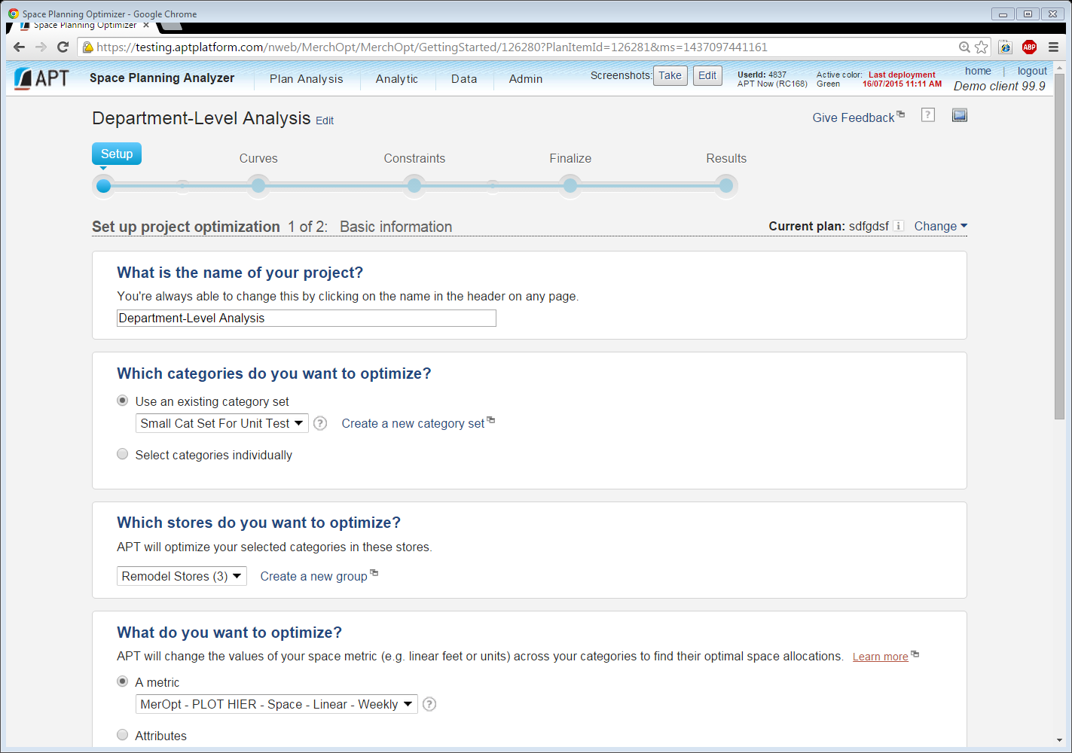
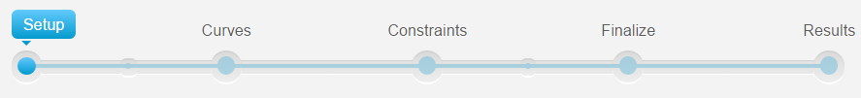
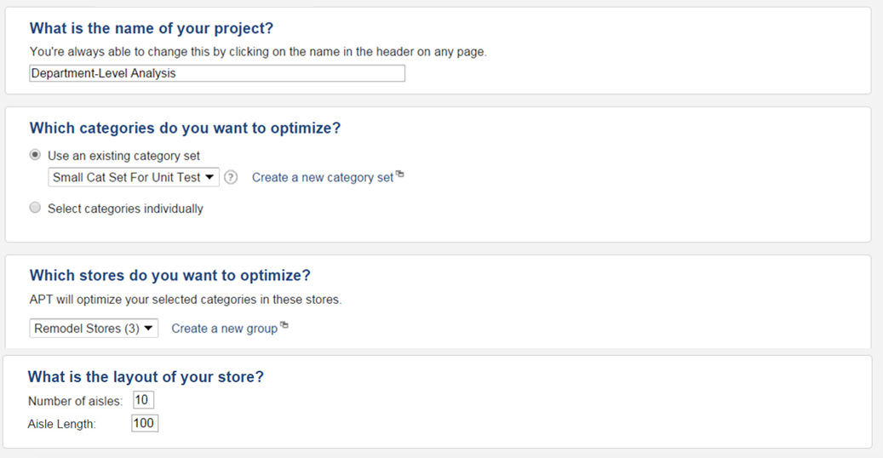
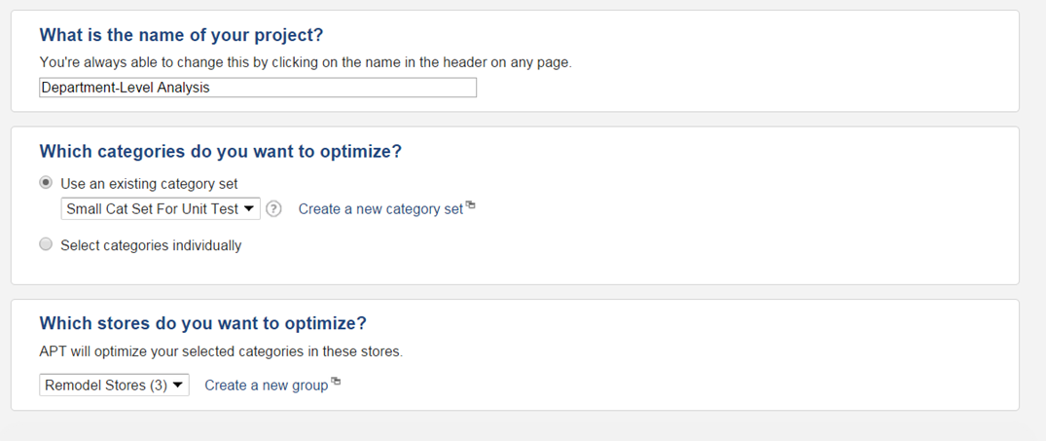

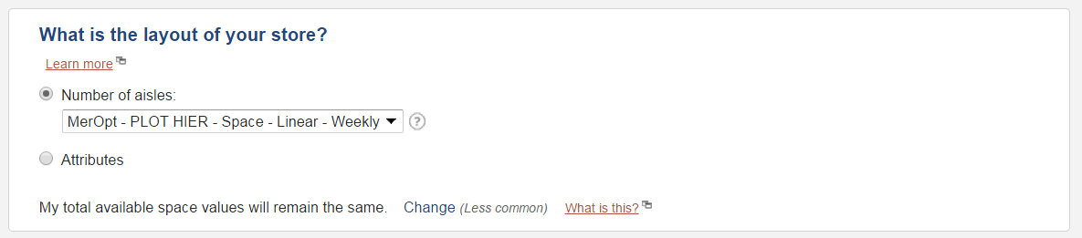




Slide 3
SPA Workflow
Categories
Categories
MBA
SPO
Category Affinities
Linear Space Allocation
SPA

Slide 4
SPA Workflow
Categories
MBA
SPO
Category Affinities
Linear Space Allocation
SPA

Slide 5
SPA Workflow
Path of Customer

Slide 6
SPA Workflow
Path of Customer

Slide 7

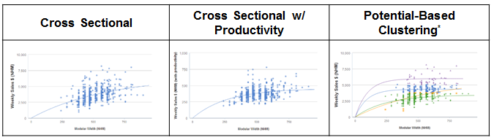
Automated Curve Building
Happens in the “Background”
Holdout simulations determine the most predictive curve for each analyzed category, automating and optimizing curve building
Wait, how do I pick curve settings?
?
1. Build curves for each category using each setting on a random 80% subset of all sets
2. Select the curve setting for each category with the closest predictions to actual for the 20% holdout group¹
3. Combine time savings and improved predictiveness from automation to profit
1. For stats people, we used MSE (mean squared error)

Slide 8

Universal “Guardrail” Constraints
Happens in the “Background”
My client would never implement that recommendation!
Recommended space changes for a given category cannot exceed minimum and maximum values for that category that exist in the group of stores used to build curves

Slide 9

Leveraging SPO
Happens in the “Background”
Automated Custom Curve Set
SPO Optimization, giving maximized space allocation across categories
Universal Guardrail Constraints
SPO was actually discovered by the Germans in the late 1800s

Slide 10

Leveraging MBA
Happens in the “Background”
During your SPA analysis, an MBA run is kicked off to calculate the affinities between each category combination in your analysis
You threw in MBA too? Honestly, I’m not even mad, I’m impressed

Slide 11

Location-Planning Analytics
Happens in the “Background”
Affinities from the MBA run are used to determine locations of space-optimized categories within your category set
Assumptions
Distance between categories with high affinity should be minimized
Customers travel on a defined path through your category set
Your analysis includes categories under the same direct parent category
arg
max
d
I’m not gonna lie, I like where this is going

Slide 12
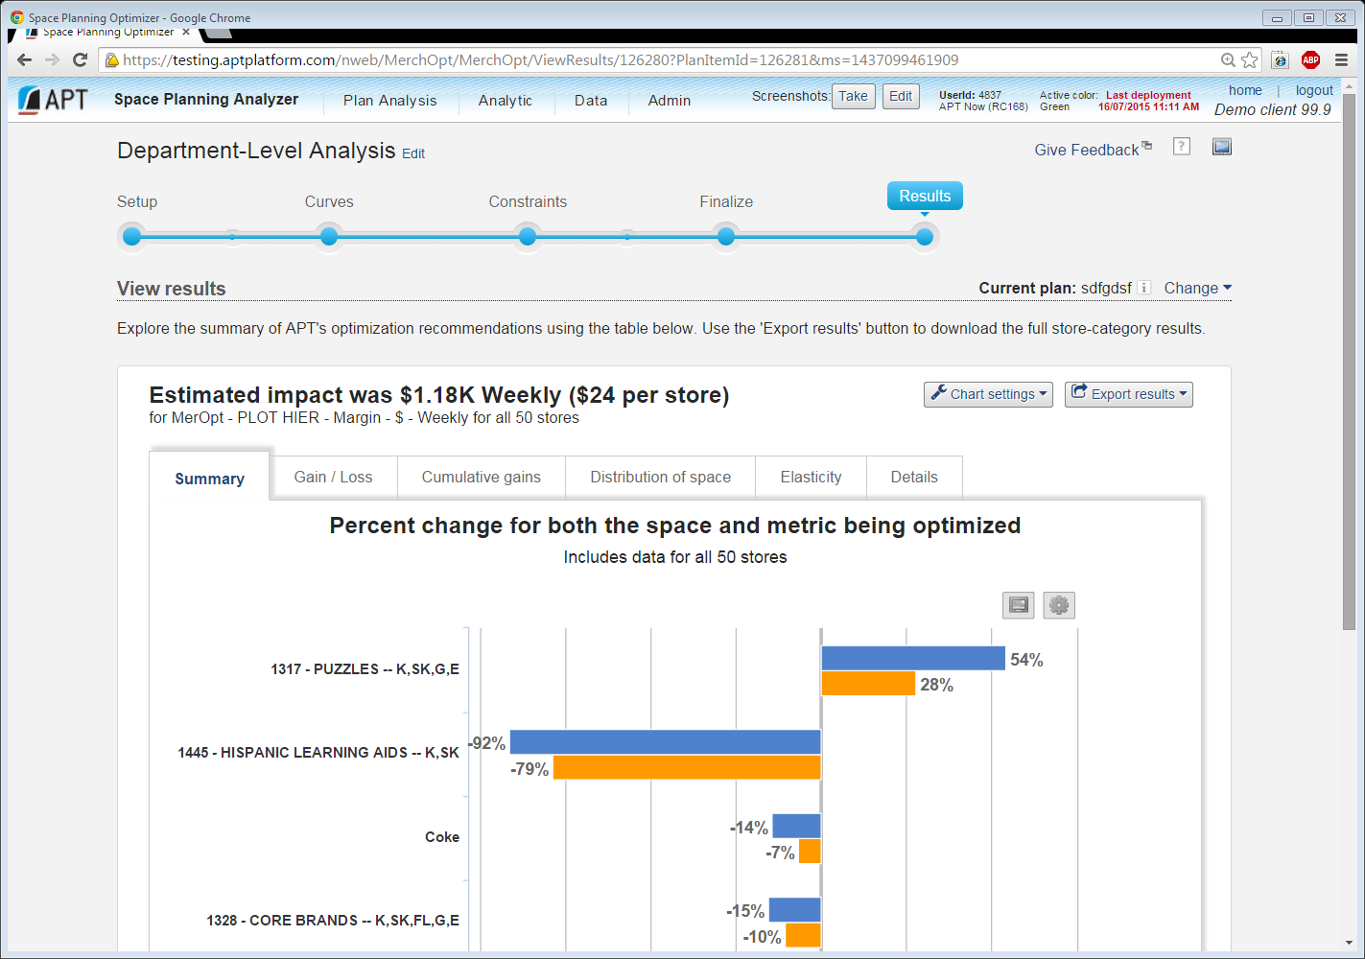
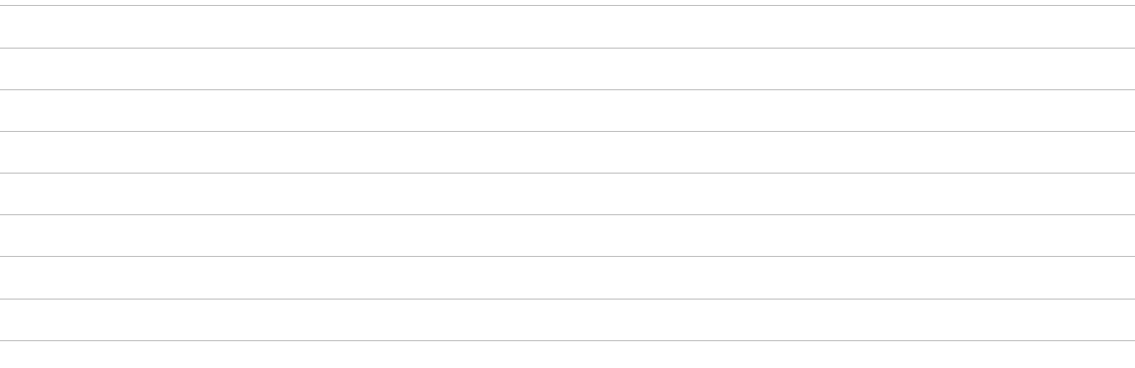

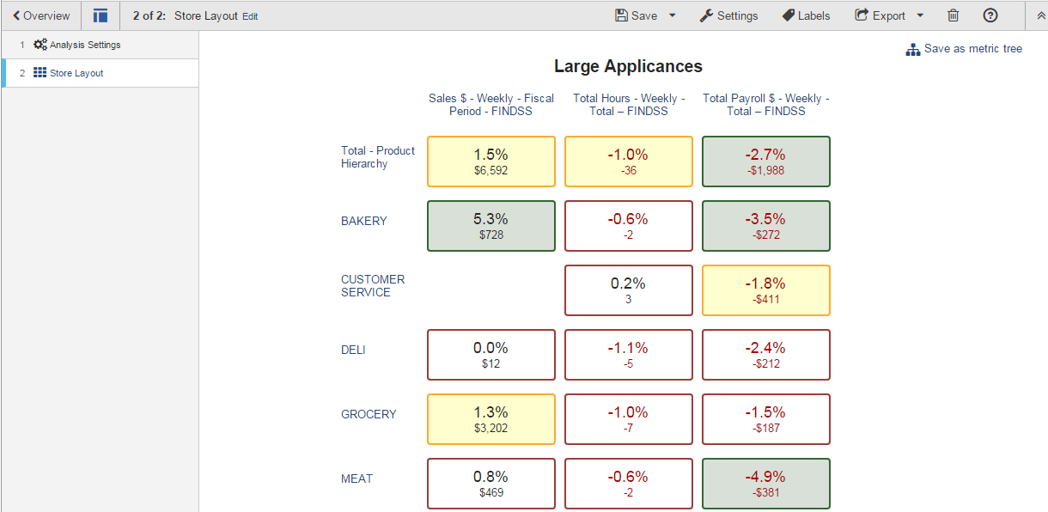
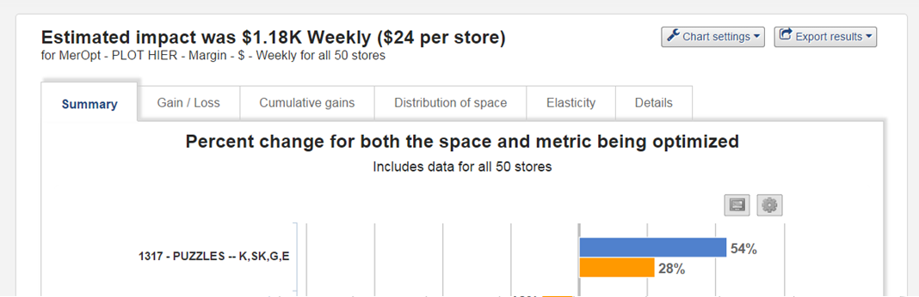








SCOTCH
Aisle 2 Allocation: 26 linear ft.

